Slide 1
CPS Framework Ontology – Balduccini/Vishik
Approach and Formalization
Notes:
In the complete deck, replace slides: 104-147

Slide 2

Goals
Demonstrate
Formalization of CPS Model and surrounding domain
Formalization of attacks, their effects, mitigation actions
Reasoning about aspects, concerns, properties
Recursive traversal of concern trees
Reasoning about physical ramifications
Finding mitigations, reasoning about their effects

Slide 3

Approach
Combination of:
Ontologies and ontology-based reasoning
Boolean satisfiability and Answer Set Programming (ASP)
Non-monotonic logic
Action languages
Constraint satisfaction
Soft constraints

Slide 4

Progress
Studied 3 scenarios
Automotive/Cam - Lane Keeping/Assist
Automotive/Sensors - Adaptive Cruise Control
Check colors and line-styles
Single level of decomposition considered
Formalized
Aspects
Concerns
Properties
Constraints/Trade-offs
Their interactions and dependencies
Reasoning
Satisfaction of properties, concerns, aspects
Exogenous events, interactions with surrounding environment
Determination of mitigations
Generalized CPS diagram for a collection of use-cases

Slide 5
Formalization

Slide 6
Goals of the Formalization
Capture relevant knowledge about a CPS
CPS-independent: Aspects/Concerns hierarchy
CPS-specific: Properties
Constraints, dependencies, tradeoffs
General-purpose, e.g. thermodynamics
CPS-specific, e.g.:
Component dependencies
Property dependencies
Effects of malware
Enable reasoning about:
The current state of the CPS
Both logical and physical
Which Properties are violated
Which Aspects/Concerns are currently satisfied
How to reach a desired state
Recovery to mission capability

Slide 7
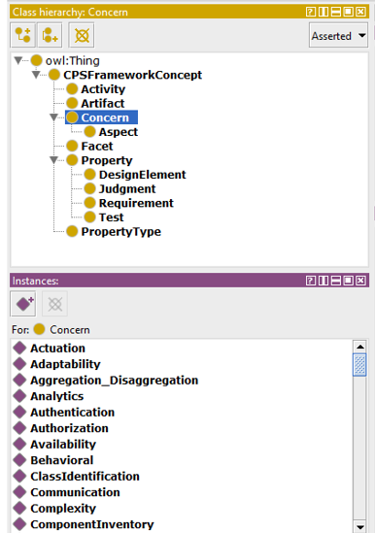
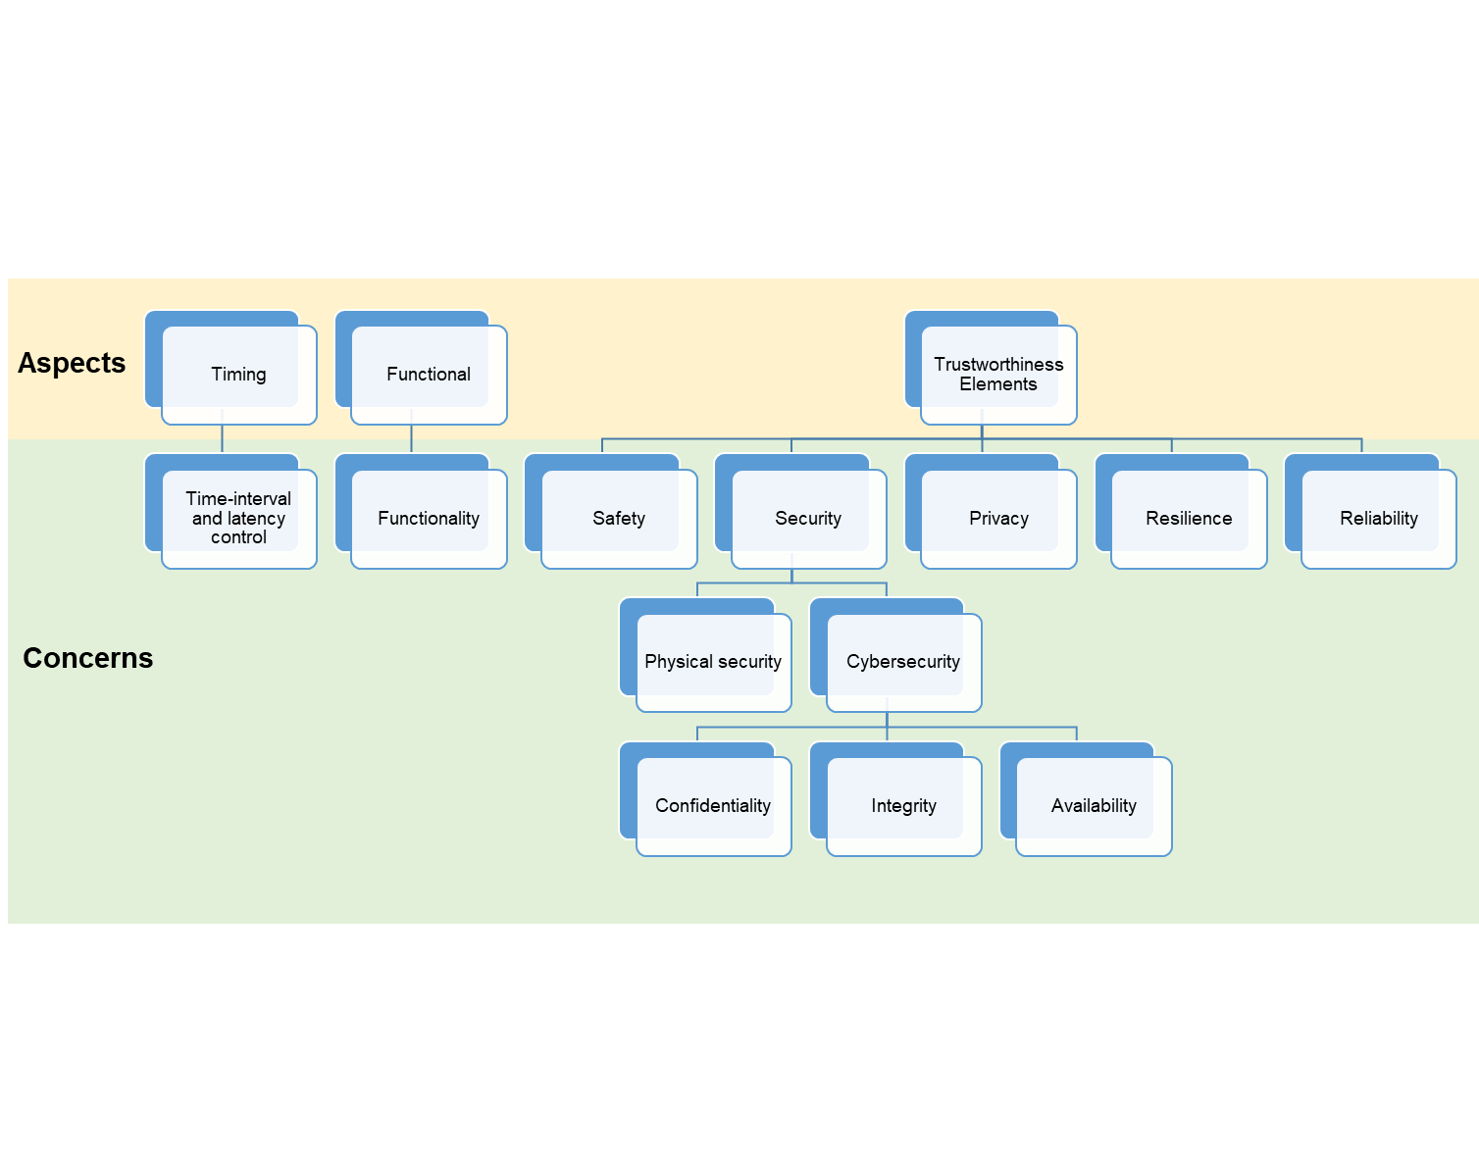
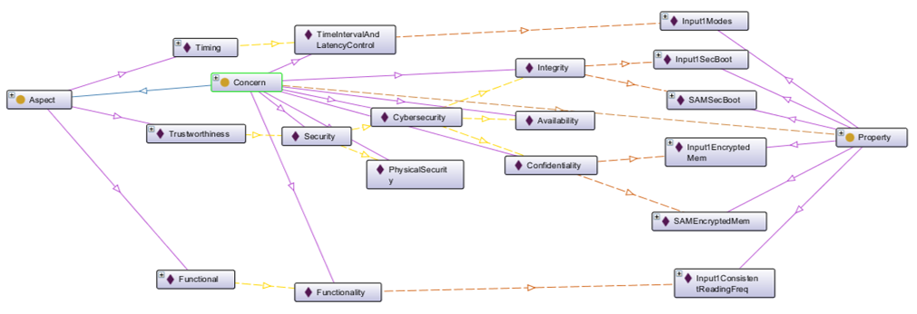
Proposed Formalization Components
Aspect/Concern hierarchy
Within CPS Framework

Slide 8
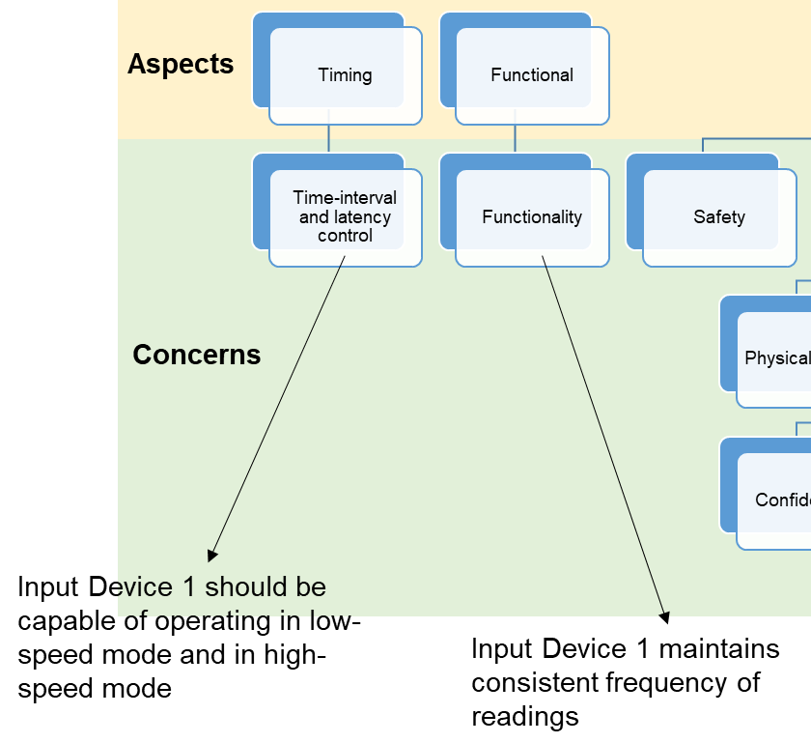
Proposed Formalization Components
Properties
Each concern is associated with a set of properties
Within CPS Framework

Slide 9
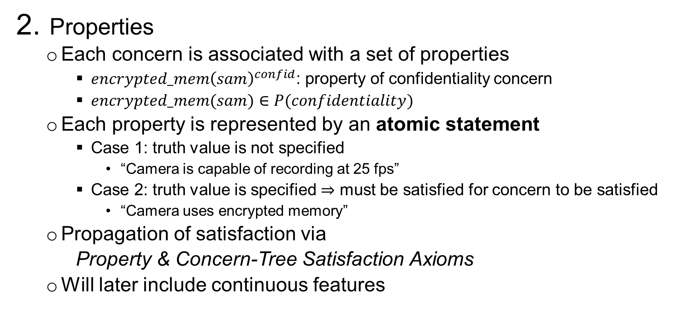
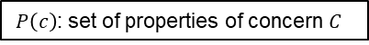
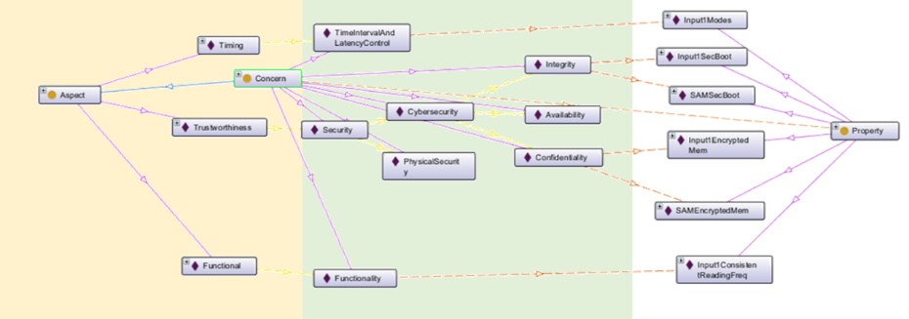
Proposed Formalization Components
Within CPS Framework

Slide 10
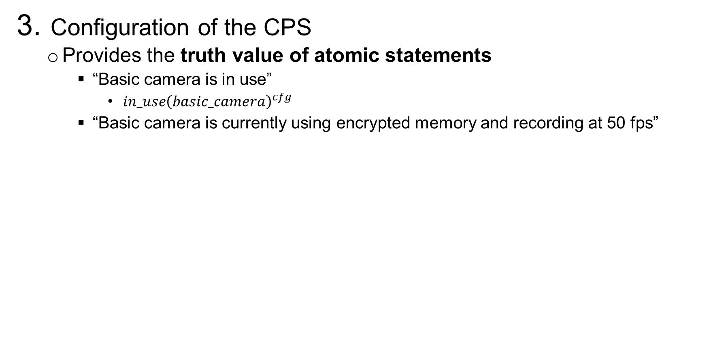
Proposed Formalization Components
Beyond CPS Framework

Slide 11
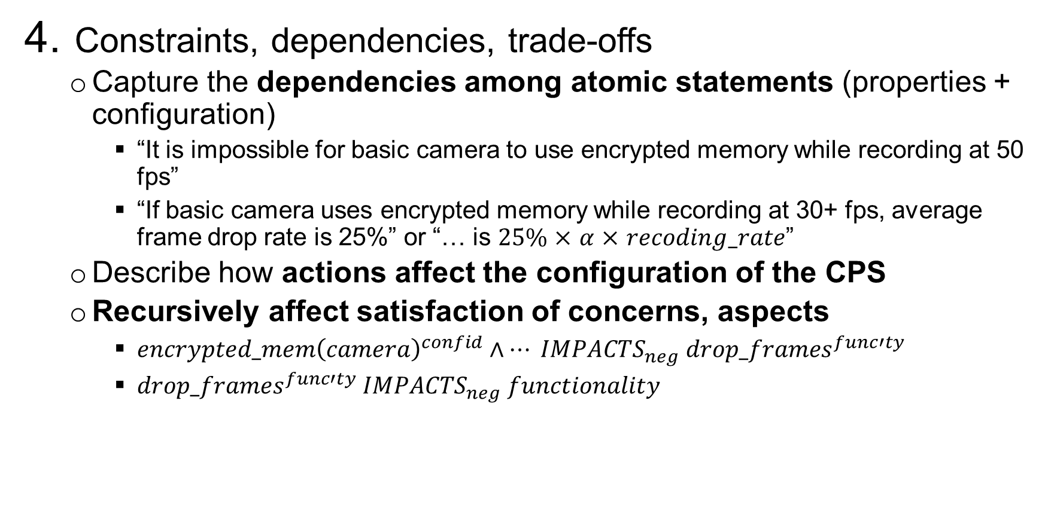
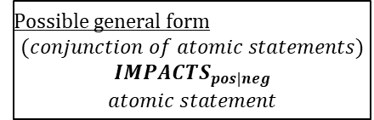
Proposed Formalization Components
Beyond CPS Framework

Slide 12
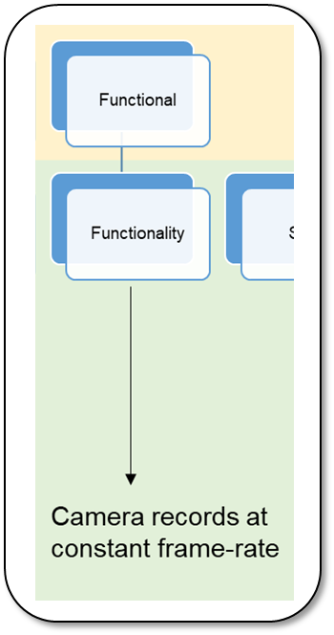
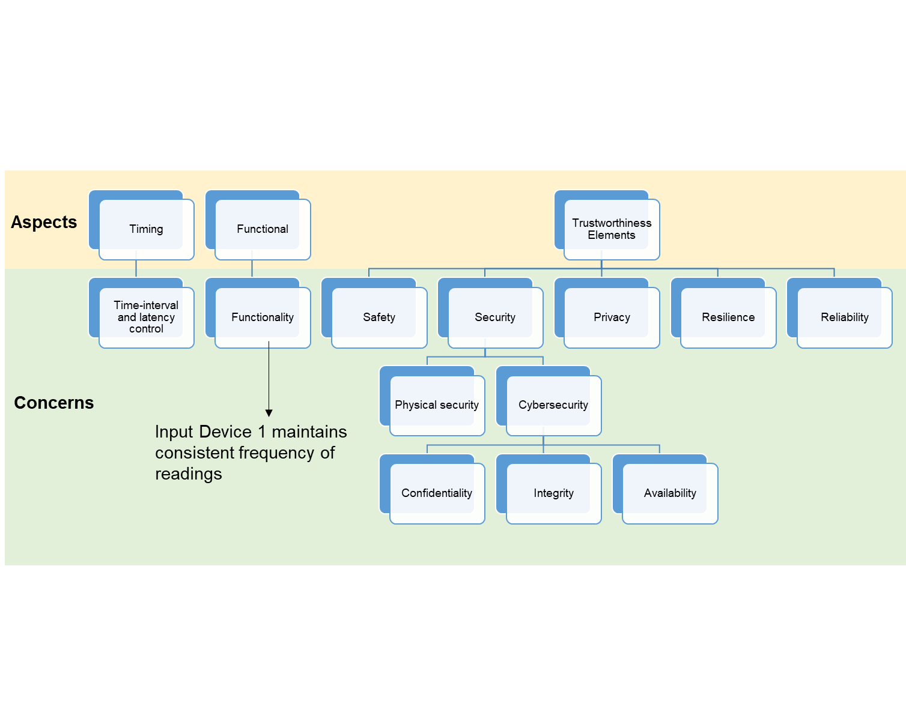
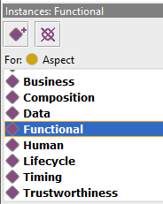
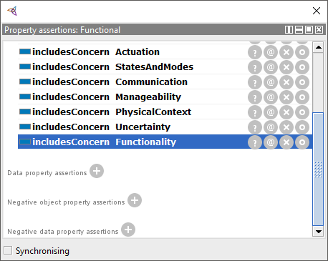
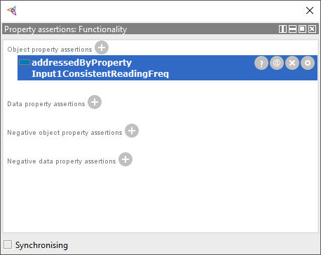
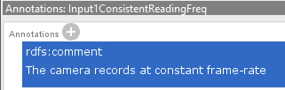
Formalization Example
Functionality Concern
Input Device 1 maintains consistent frequency of readings
Functional Aspect
Functionality Concern
Concern’s Property
Property’s Description
<owl:NamedIndividual rdf:about=“http://...#Functional">
<rdf:type rdf:resource="http://...#Aspect"/>
...
<includesConcern rdf:resource="http://...#Functionality"/>
<owl:NamedIndividual rdf:about="http://...#Functionality">
<rdf:type rdf:resource="http://...#Concern"/>
<addressedByProperty rdf:resource="http://...#Input1ConsistentReadingFreq"/>
</owl:NamedIndividual>
Property & Concern-Tree Satisfaction Axioms
<owl:NamedIndividual rdf:about="http://...#Input1ConsistentReadingFreq">
<rdf:type rdf:resource="http://...#Property"/>
<rdfs:comment>The camera records at constant frame-rate</rdfs:comment>
<atomicStatement>consist_reading_freq_input1</atomicStatement>
...
-holds(sat_concern(C),S) :-
step(S),
addressedBy(C,P),
-holds(sat_property(P),S).
-holds(sat_property(P),S) :-
step(S),
not holds(P,S).

Slide 13
Generalized Integrated Monitoring & Control System Can be specialized into any of the example systems discussed later
Physical connection
Direct logical connection
“Generalized” components circled in red
text
Description of interaction
text
Annotation
operating environment
Physical element
o1
Influence: config change
Energy: mechanical
f1a
Influence: TBD
Logical element
f1b
Influence: TBD
Physical & logical system
cmd1
Message: command packet
Information: type of warning, attributes
reconfig
mech
input1
input2
indicator
f2b
Message: byte seq.
Information: feed
contains f1b
configurable
input
remote station
f2a
Message: byte seq.
Information: feed
contains f1a
SAM
cmd2
Message: command packet
Information: new config
notification1
Message: notification packet
Information: type of notification, timestamp, location, user ID
user
combof1
Message: byte seq.
Information: combined input feeds
contains f2a
contains f2b
integrated monitoring & control system (stand-alone part)
storage
us1
Influence: user signal
combof2
Influence: audio, video, other signals
integrated monitoring & control system
recipient

Slide 14
Aspects, Concerns, Properties for Generalized Integrated Monitoring & Control System
Trustworthiness Elements
Safety
Reliability
Security
Physical security
Confidentiality
Integrity
Availability
Privacy
Resilience
Cybersecurity
Functionality
Functional
Timing
Time-interval and latency control
Note: unless otherwise specified, “camera” refers
to both basic and advanced camera
Aspects
Concerns
Input Device 1 should be capable of operating in low-speed mode and in high-speed mode
SAM uses secure boot
Input Device 1 uses secure boot
Input Device 1 maintains consistent frequency of readings
SAM uses encrypted memory
Input Device 1 uses encrypted memory

Slide 15

Summary of Examples
Simplified “Body Camera”
Camera
SAM
Minimal assumptions on knowledge about connections
Link to broader domain: admissibility of video in court
Self-Driving Car (a)
Camera
SAM
Broader domain: consequences on car’s operations
Self-Driving Car (b)
Sensors
SAM
Broader domain: consequences on car’s operations

Slide 16
Reasoning over Trustworthiness – Balduccini
Use-Cases and Reasoning Examples
Notes:
In the complete deck, replace slides: 104-147

Slide 17
Summary of Examples
Simplified “Body Camera”
Camera
SAM
Minimal assumptions on knowledge about connections
Link to broader domain: admissibility of video in court
Self-Driving Car (a)
Camera
SAM
Broader domain: consequences on car’s operations
Self-Driving Car (b)
Sensors
SAM
Broader domain: consequences on car’s operations

Slide 18
Example 1 Body Camera
An integrated body security system for situational awareness and safety of security personnel

Slide 19
Example 1 “BodyCam” Diagram
Physical connection
Direct logical connection
text
Description of interaction
text
Annotation
operating environment
Physical element
o1
Influence: angle change
Energy: mechanical
vf1
Influence: video signal
Energy: electr. waves
Logical element
af1
Influence: audio signal
Energy: sound waves
Physical & logical system
cmd1
Message: command packet
Information: type of warning, attributes
targeting
mech
camera
mic
indicator
af2
Message: byte seq.
Information: audiofeed
contains af1
encoding AES
robotic camera
command center
vf2
Message: byte seq.
Information: videofeed
contains vf1
encoding AES
SAM
alarm1
Message: alarm packet
Information: type of alarm, timestamp, location, officer ID
cmd2
Message: command packet
Information: degrees, speed
officer
avf1
Message: byte seq.
Information: combined videofeed, audiofeed
contains vf2
contains af2
encoding AES
integrated body security system (stand-alone part)
storage
ws1
Influence: warning signal
Energy: waves TBD
avf2
Influence: audio-video signal
Information: sound, light waves
integrated body security system
court

Slide 20
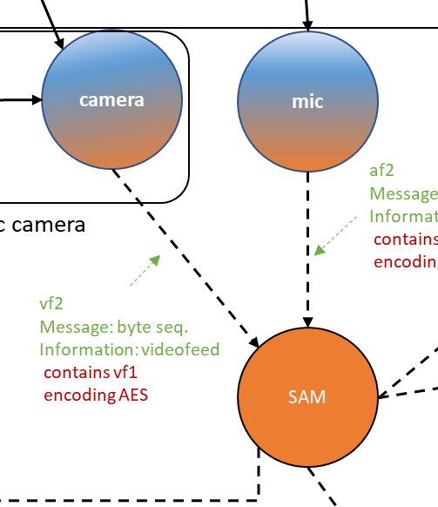
Example 1 Simplified “BodyCam”
Actors
Camera
Basic camera
Advanced camera
Two modes:
Record at 25 fps
Record at 50 fps
Security features (may be enabled)
Encrypted memory
Secure boot
SAM (Situational Awareness Module)
SAM controls the recording rate

Slide 21
Aspects, Concerns, Properties
Trustworthiness Elements
Safety
Reliability
Security
Physical security
Confidentiality
Integrity
Availability
Privacy
Resilience
Cybersecurity
Functionality
Functional
Timing
Time-interval and latency control
Note: unless otherwise specified, “camera” refers to both basic and advanced camera
Aspects
Concerns
Camera should be capable of recording at 25 fps or at 50 fps
Camera records at constant frame-rate
SAM uses secure boot
Camera uses sec. boot
SAM uses encrypted memory
Camera uses encrypted memory

Slide 22
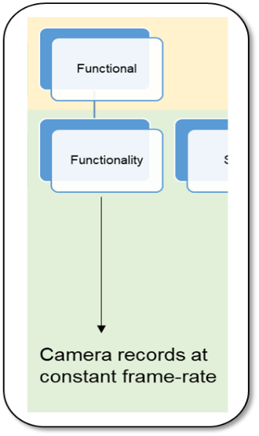

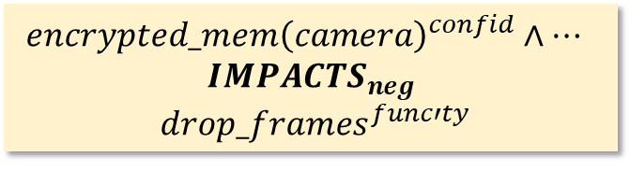
Formalization
Aspect/Concern hierarchy
Properties
Configuration of the CPS
Constraints, dependencies, trade-offs
5. Property & Concern-Tree Satisfaction Axioms
(semantics of the specification)
Within CPS
Framework
$$in_use{\left(basic_camera\right)}^{cfg}$$
$$encrypted_mem{\left(camera\right)}^{confid}∧…$$
$IMPACTS_{neg}$
$drop_frames^{func′ty}$
Beyond CPS
Framework
-holds(sat_concern(C),S) :-
step(S),
addressedBy(C,P),
-holds(sat_property(P),S).
-holds(sat_property(P),S) :-
step(S),
not holds(P,S).

Slide 23
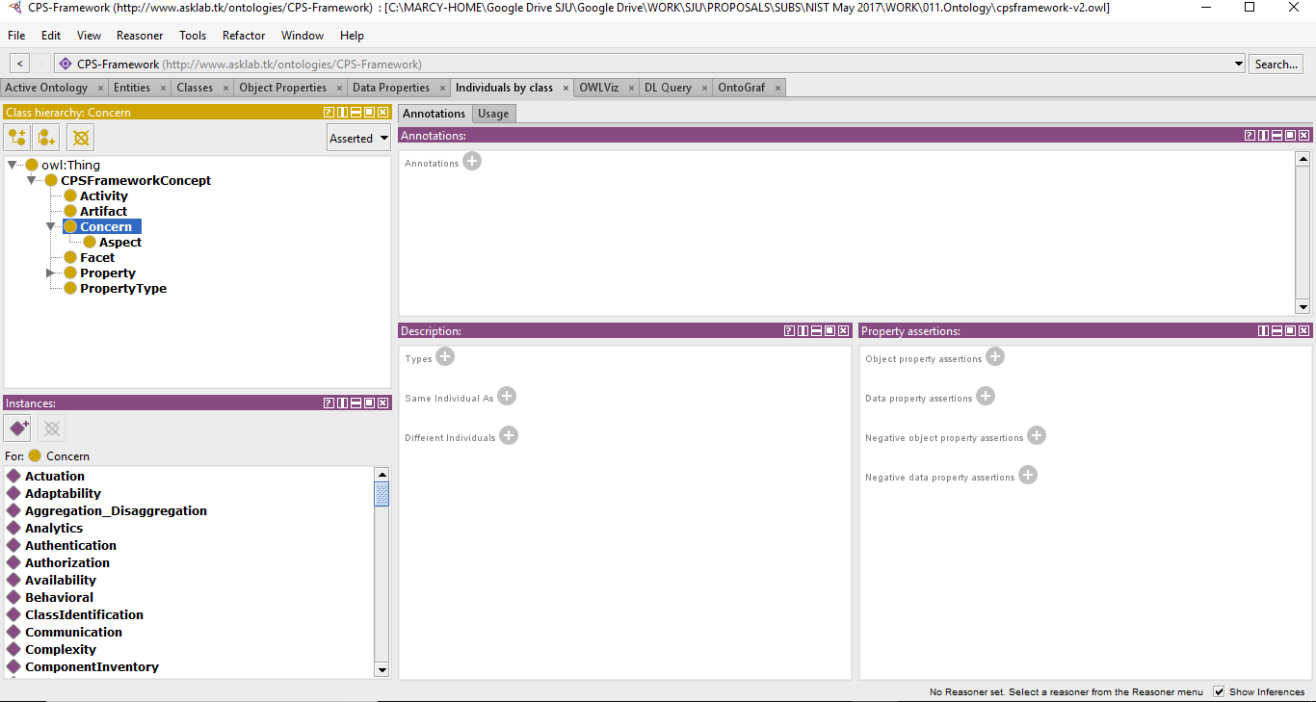
Formalization
Trustworthiness Elements
Safety
Reliability
Security
Physical security
Confidentiality
Integrity
Availability
Privacy
Resilience
Cybersecurity
Functionality
Functional
Timing
Time-interval and latency control
Aspect/Concern Class Hierarchy
Concerns
Aspects
Concerns
Aspect/Concern Hierarchy
Concern, Aspect: classes
Sub-concerns: relation
includesConcern

Slide 24
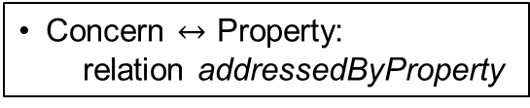
Formalization
Functionality Concern
Camera records at constant frame-rate
Functional Aspect
Functionality Concern
Concern $↔$ Property:
relation addressedByProperty
Concern’s Property
Property’s Description
<owl:NamedIndividual rdf:about=“http://...#Functional">
<rdf:type rdf:resource="http://...#Aspect"/>
...
<includesConcern rdf:resource="http://...#Functionality"/>
<owl:NamedIndividual rdf:about="http://...#Functionality">
<rdf:type rdf:resource="http://...#Concern"/>
<addressedByProperty rdf:resource="http://...#Input1ConsistentReadingFreq"/>
</owl:NamedIndividual>
Property & Concern-Tree Satisfaction Axioms
<owl:NamedIndividual rdf:about="http://...#Input1ConsistentReadingFreq">
<rdf:type rdf:resource="http://...#Property"/>
<rdfs:comment>The camera records at constant frame-rate</rdfs:comment>
<atomicStatement>consist_reading_freq_input1</atomicStatement>
...
-holds(sat_concern(C),S) :-
step(S),
addressedBy(C,P),
-holds(sat_property(P),S).
-holds(sat_property(P),S) :-
step(S),
not holds(P,S).

Slide 25
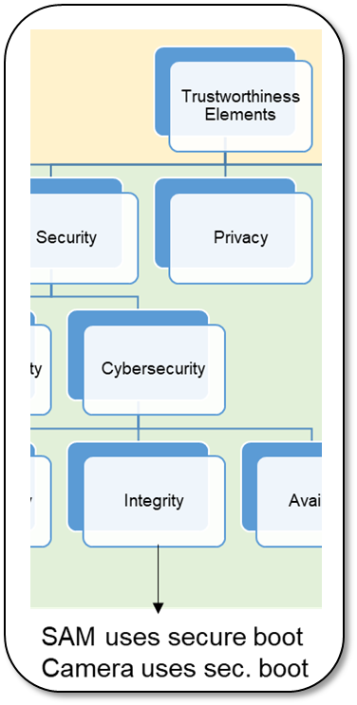
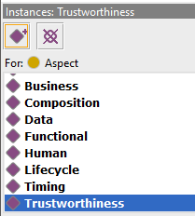
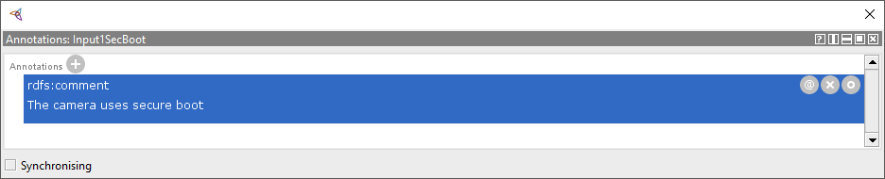
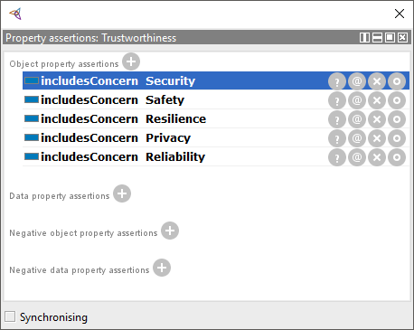
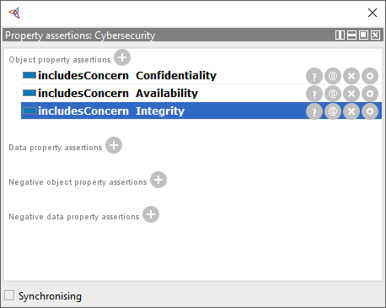
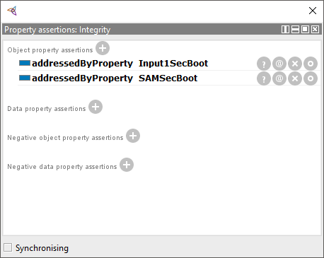
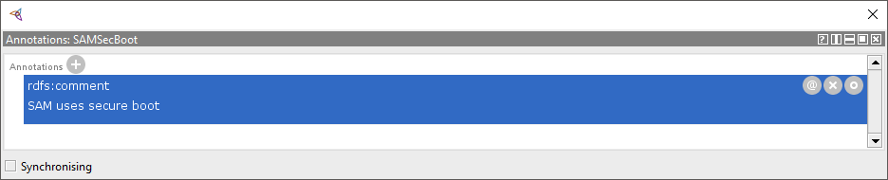
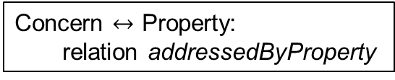
Formalization
Integrity Concern
SAM uses secure boot
Camera uses secure boot
Trustworthiness Aspect
<owl:NamedIndividual rdf:about="http://...#Trustworthiness">
<rdf:type rdf:resource="http://...#Aspect"/>
...
<includesConcern rdf:resource="http://...#Security"/>
Property & Concern-Tree Satisfaction Axioms
<owl:NamedIndividual rdf:about="http://...#Cybersecurity">
<rdf:type rdf:resource="http://...#Concern"/>
...
<includesConcern rdf:resource="http://...#Integrity"/>
<owl:NamedIndividual rdf:about="http://...#Input1SecBoot">
<rdfs:comment>The camera uses secure boot</rdfs:comment>
...
<owl:NamedIndividual rdf:about="http://...#SAMSecBoot">
<rdfs:comment>SAM uses secure boot</rdfs:comment>
...
<owl:NamedIndividual rdf:about="http://...#Integrity">
<rdf:type rdf:resource="http://...#Concern"/>
<addressedByProperty rdf:resource="http://...#Input1SecBoot"/>
<addressedByProperty rdf:resource="http://...#SAMSecBoot"/>
Security Concern
Integrity Concern
Concern’s Properties
Concern $↔$ Property:
relation addressedByProperty

Slide 26
Example 1
System Configuration
SAM and camera use encrypted memory and secure boot
Recording rate set at 25 fps by SAM
Basic camera is used
Formalization
obs("encrypted_mem_input1",true).
obs("encrypted_mem_sam",true).
obs("sec_boot_input1",true).
obs("sec_boot_sam",true).
obs("slow_mode_input1",true).
obs("using_basic_input1",true).
obs(<atomic statement>,<true|false>).

Slide 27
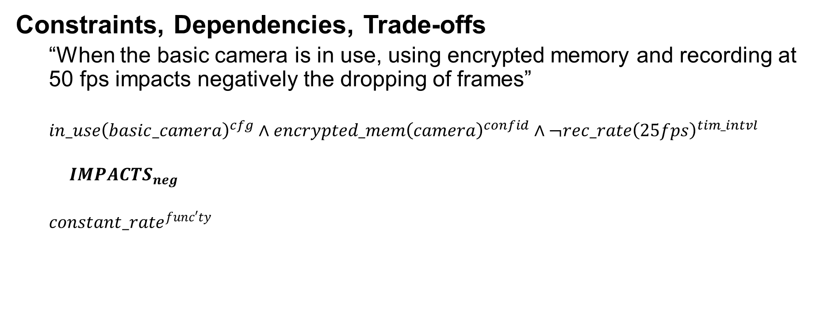
Example 1
Formalization
impacted(neg,"consist_reading_freq_input1",S) :-
step(S),
holds("using_basic_input1",S),
holds("encrypted_mem_input1",S),
-holds("slow_mode_input1",S).

Slide 28
Example 1
System Configuration
SAM and camera use encrypted memory and secure boot
Basic camera is used
Recording rate set at 25 fps by SAM
Questions
Is the functionality concern satisfied?

Slide 29
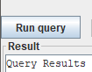
Example 1
System Configuration
SAM and camera use encrypted memory and secure boot
Basic camera is used
Recording rate set at 25 fps by SAM
Questions
Is the functionality concern satisfied?
Outcome of the reasoning process:
Trustworthiness concern tree
(fragment)
holds(sat_concern("cpsf:Functionality"),0)
holds(F,S): F true at step S
-holds(F,S): F false at S
Functionality concern is satisfied

Slide 30
Example 1
System Configuration
SAM and camera use encrypted memory and secure boot
Basic camera is used
Recording rate set at 25 fps by SAM
Questions
Is the functional aspect satisfied?
Outcome of the reasoning process:
Functional concern tree
holds(sat_concern("cpsf:Functional"),0)
Functional aspect is satisfied

Slide 31
Example 1
System Configuration
SAM and camera use encrypted memory and secure boot
Basic camera is used
Recording rate set at 25 fps by SAM
Questions
Are all aspects satisfied?
Outcome of the reasoning process:
holds(sat_all,0)
All aspects are satisfied

Slide 32
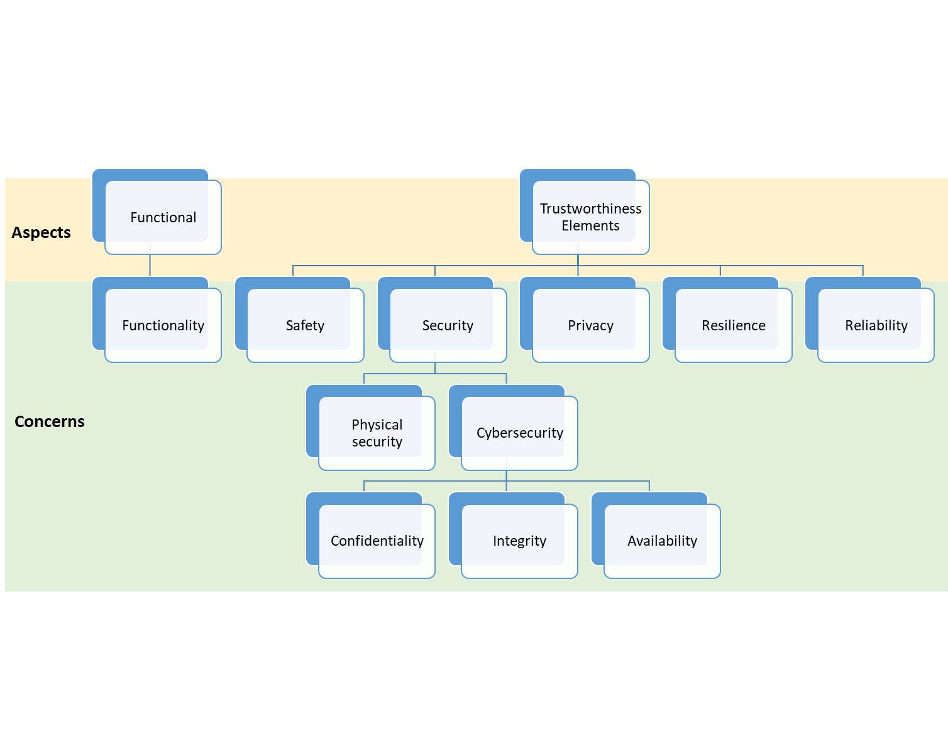
Example 1
Also tested:
Asking questions about arbitrary aspects and their concerns

Slide 33
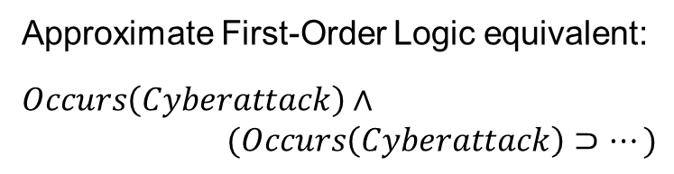
Example 1 – Step 2
System Configuration
SAM and camera use encrypted memory and secure boot
Basic camera is used
Recording rate set at 25 fps by SAM
A cyberattack occurs and hacks the SAM to activate recording at 50 fps
occurs(cyberattack,0).
holds(affected(sam),S+1) :-
step(S), occurs(cyberattack,S).
-holds("slow_mode_input1",S) :-
step(S), holds(affected(sam),S).
Effect Axioms
occurs(E,S): E occurs
at step S

Slide 34
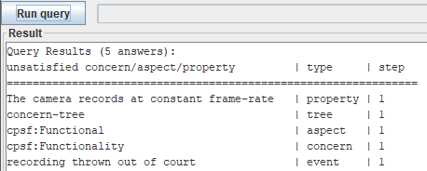
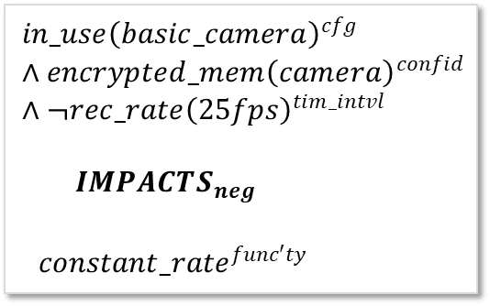
Example 1 – Step 2
System Configuration
SAM and camera use encrypted memory and secure boot
Basic camera is used
Recording rate set at 25 fps by SAM
A cyberattack occurs and hacks the SAM to activate recording at 50 fps
Questions
Is the functionality concern satisfied?
List of
unsatisfied items
Functionality concern is not satisfied

Slide 35
Example 1 – Step 2
System Configuration
SAM and camera use encrypted memory and secure boot
Basic camera is used
Recording rate set at 25 fps by SAM
A cyberattack occurs and hacks the SAM to activate recording at 50 fps
Questions
Is the functional aspect satisfied?
Functional concern tree
No

Slide 36
Example 1 – Step 2
System Configuration
SAM and camera use encrypted memory and secure boot
Basic camera is used
Recording rate set at 25 fps by SAM
A cyberattack occurs and hacks the SAM to activate recording at 50 fps
Questions
What happens in the environment?
Conclusion based on the knowledge:
event(recipient_rejects,S) :-
-holds(sat_concern("cpsf:Functional"),S).
The recording is thrown out of court

Slide 37
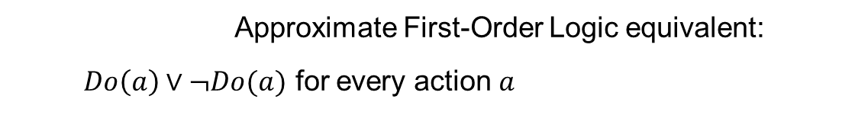
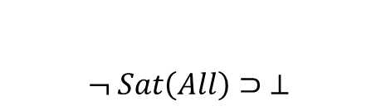
Example 1 – Step 3
System Configuration
SAM and camera use encrypted memory and secure boot
Basic camera is used
Recording rate set at 25 fps by SAM
A cyberattack occurs and hacks the SAM to activate recording at 50 fps
Questions
How can it be mitigated?
Mitigation Generation Module (Axioms)
do(A,S): execute A
at step S
do(A,S) v -do(A,S) :- step(S), action(A).
:- last_step(S),
-holds(sat_all,S).
Minimize number of actions
(soft constraint)
:~ do(A,S), action(A), step(S).

Slide 38
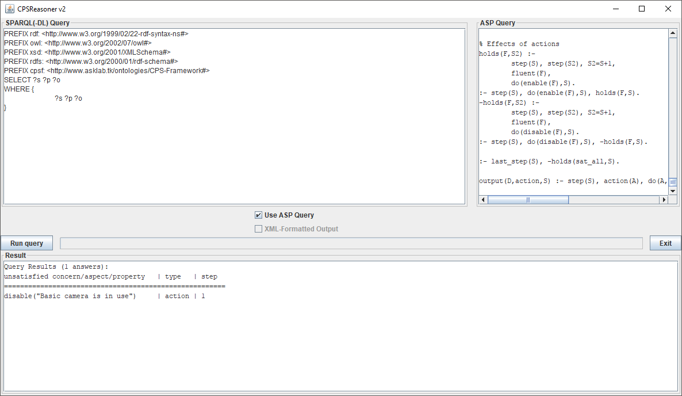
Example 1 – Step 3
System Configuration
SAM and camera use encrypted memory and secure boot
Basic camera is used
Recording rate set at 25 fps by SAM
A cyberattack occurs and hacks the SAM to activate recording at 50 fps
Questions
How can it be mitigated?
“Replace basic camera with
advanced camera”

Slide 39
Example 2 Self-Driving Car (a)
A self-driving car uses SAM and camera for lane keeping/assist

Slide 40
Example 2 Self-Driving Car (a)
Physical connection
Direct logical connection
text
Description of interaction
text
Annotation
operating environment
Physical element
o1
Influence: angle change
Energy: mechanical
vf1
Influence: video signal
Energy: electr. waves
Logical element
af1
Influence: audio signal
Energy: sound waves
Physical & logical system
cmd1
Message: command packet
Information: type of warning, attributes
targeting
mech
camera
mic
indicator
af2
Message: byte seq.
Information: audiofeed
contains af1
encoding AES
robotic camera
remote assit
vf2
Message: byte seq.
Information: videofeed
contains vf1
encoding AES
SAM
alarm1
Message: alarm packet
Information: type of alarm, timestamp, location, driver ID
cmd2
Message: command packet
Information: degrees, speed
driver
avf1
Message: byte seq.
Information: combined videofeed, audiofeed
contains vf2
contains af2
encoding AES
integrated lane keeping/assist system (stand-alone part)
storage
ws1
Influence: warning signal
Energy: waves TBD
ctrl1
Message: angle change
Information: mechanical
integrated lane keeping/assist system
steering wheel

Slide 41
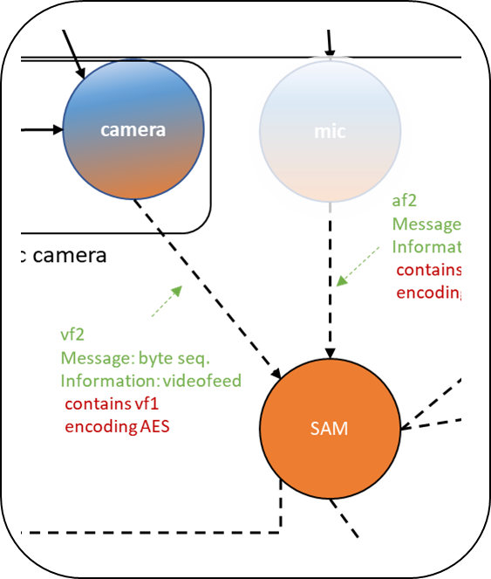
Example 2: Self-Driving Car (a)
A self-driving car uses SAM and camera for lane keeping/assist
Actors
Camera
Basic camera
Advanced camera
Two modes:
Record at 25 fps
Record at 50 fps
Security features (may be enabled)
Encrypted memory
Secure boot
SAM (Situational Awareness Module)
SAM controls the recording rate
steering

Slide 42
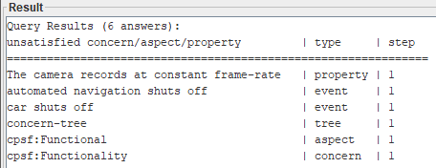
Example 2: Self-Driving Car (a)
System Configuration
SAM and camera use encrypted memory and secure boot
Basic camera is used
Recording rate set to 25 fps by SAM
A cyberattack occurs and hacks the SAM to activate recording at 50 fps
Questions
Is the functionality concern satisfied?
Is the functional aspect satisfied?
What are the physical ramifications?
How can it be mitigated?
“Replace the basic camera with the advanced camera”

Slide 43
Example 3 Self-Driving Car (b)
A self-driving car uses SAM and sensors for adaptive cruise control

Slide 44
Example 2 Self-Driving Car (b)
Physical connection
Direct logical connection
text
Description of interaction
text
Annotation
operating environment
Physical element
vf1
Influence: video signal
Energy: electr. waves
Logical element
o1
Influence: angle change
Energy: mechanical
af1
Influence: audio signal
Energy: sound waves
Physical & logical system
cmd1
Message: command packet
Information: type of warning, attributes
targeting
mech
sensor
mic
indicator
af2
Message: byte seq.
Information: audiofeed
contains af1
encoding AES
robotic sensor
remote assit
vf2
Message: byte seq.
Information: feed
contains vf1
encoding AES
SAM
alarm1
Message: alarm packet
Information: type of alarm, timestamp, location, driver ID
cmd2
Message: command packet
Information: degrees, speed
driver
integrated adaptive cruise control system (stand-alone part)
avf1
Message: byte seq.
Information: combined feeds
contains vf2
contains af2
encoding AES
storage
ctrl1
Influence: angle change
energy: mechanical
ctrl2
Influence: angle change
energy: mechanical
ws1
Influence: warning signal
Energy: waves TBD
integrated adaptive cruise control system
accelerator
brake

Slide 45
Example 3: Self-Driving Car (b)
A self-driving car uses SAM and sensors for adaptive cruise control
Actors
Sensor array
Interpolating sensor array (inaccurate hardware, interpolation compensates)
Non-interpolating sensor array (accurate hardware)
SAM (Situational Awareness Module)
SAM requests sensor readings either at low rate or high rate
In interpolating sensor array:
High request rate causes interpolation to be cut short
Potentially leads to inaccurate data returned to SAM

Slide 46
Example 3: Self-Driving Car (b)
System Configuration
SAM and sensors use encrypted memory and secure boot
Interpolating sensor array is used
SAM requests sensor readings at low rate
Questions
Is the functionality concern satisfied?
Is the functional aspect satisfied?
Are all aspects satisfied?

Slide 47
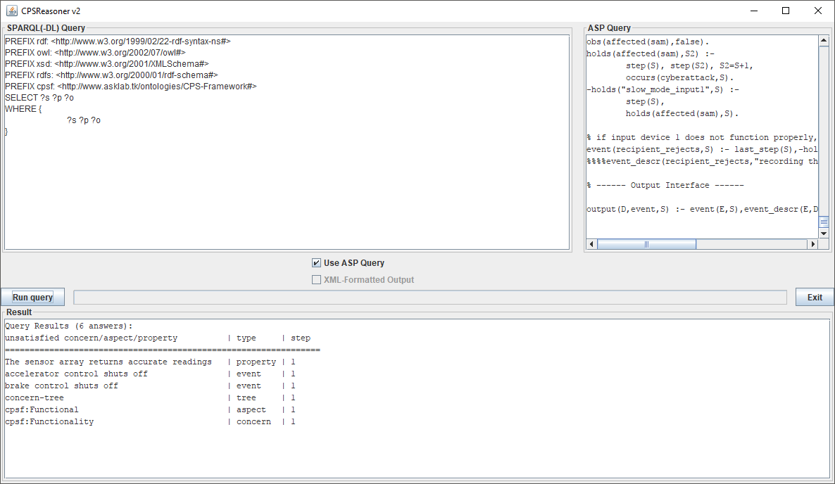
Example 3 – Step 2
System Configuration
SAM and sensor array use encrypted memory and secure boot
Interpolating sensor array is used
SAM requests sensor readings at low rate
A cyberattack occurs and hacks the SAM to request readings at a high rate
Questions
Is the functionality concern satisfied?
Is the functional aspect satisfied?
What are the physical ramifications?

Slide 48
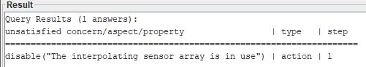
Example 3 – Step 2
System Configuration
SAM and sensor array use encrypted memory and secure boot
Interpolating sensor array is used
SAM requests sensor readings at low rate
A cyberattack occurs and hacks the SAM to request readings at a high rate
Questions
Is the functionality concern satisfied?
Is the functional aspect satisfied?
What are the physical ramifications?
How can it be mitigated?
“Replace interpolating sensor array with non-interpolating”

Slide 49
Example 3 (Variant) Multiple Possible Mitigations

Slide 50
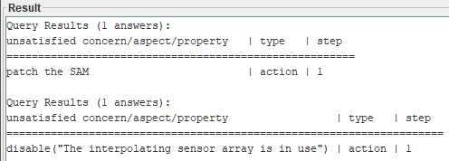
Example 3 – Step 3 (Extended)
System Configuration
SAM and sensor array use encrypted memory and secure boot
Interpolating sensor array is used
SAM requests sensor readings at low rate
A cyberattack occurs and hacks the SAM.
Unless a patch is applied, the SAM will request readings at a high rate.
Questions
How can it be mitigated?
Effect of patching (Axioms)
-holds(affected(sam),S+1) :-
step(S), step(S+1), do(patch(sam),S).
holds("slow_mode_input1",S+1) :-
step(S), step(S+1), do(patch(sam),S).
Solution #1
“Patch the SAM”
Solution #2

Slide 51
Conclusions
Demonstrated
Formalization of CPS Model and surrounding domain, attacks, mitigations
Reasoning about concerns, properties, physical ramifications
Finding (multiple) mitigations, reasoning about their effects
Three examples: “BodyCam”, Self-driving Car (lane assist/keep & adaptive cruise control)
Next Steps
Formalization, leverage of knowledge about CPS structure
Reason over multiple levels of decomposition

